Slide 1


DEPARTMENT OF ELECTRONICS AND TELECOMMUNICATION ENGINEERING
A Voice-Controlled Obstacle-Detector Autonomous Bot
The Project is DEVELOPED By:
Agniban Goswami Exam Roll No. 510714009
Sarthak Shekhar Roy Paul Exam Roll No. 510714010
Pratim Dasmahapatra Exam Roll No. 510714012
(All are currently students of 2nd year in Dept. of Electronics and Telecommunication Engineering pursuing B.Tech-M.Tech Dual Degree at Indian Institute of Engineering Science & Technology, Shibpur)

Slide 2
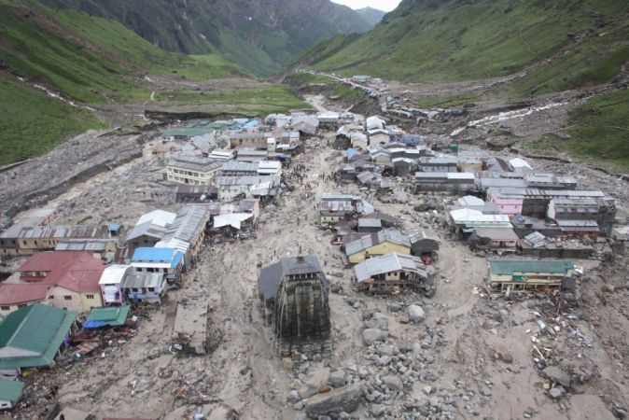
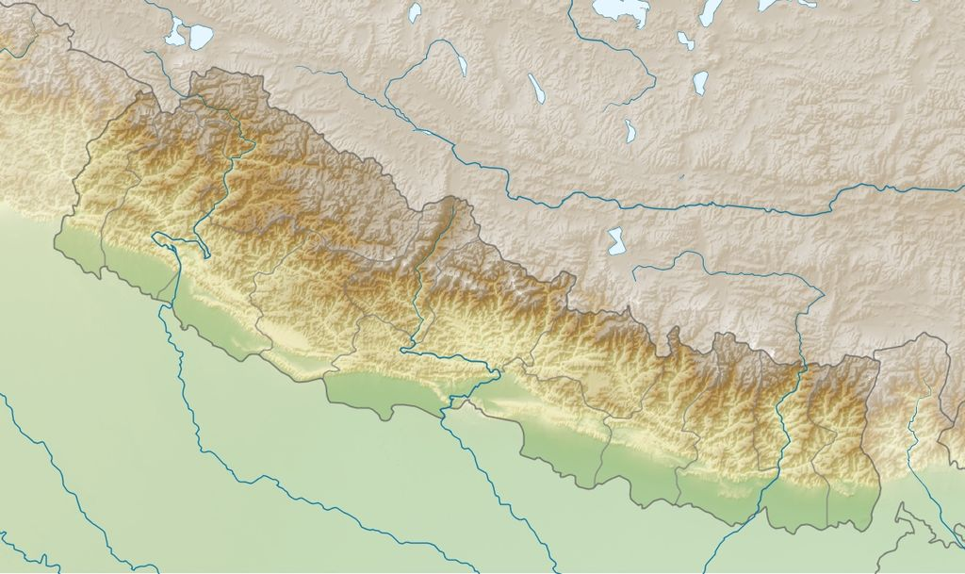
25 APRIL 2015, 11:56 AM
NEPAL

Slide 3
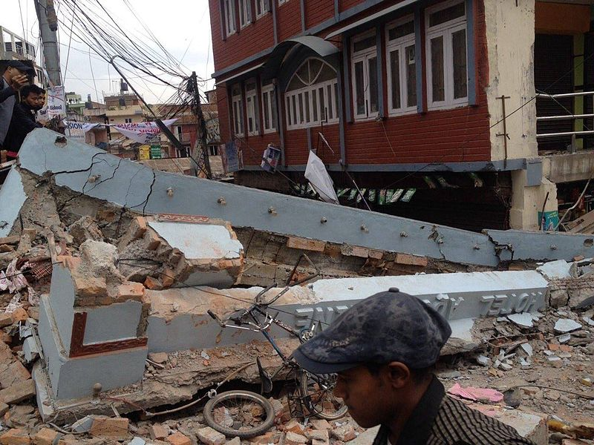
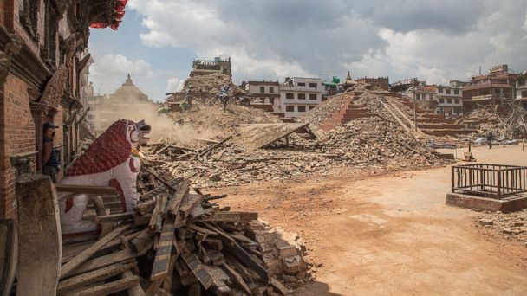
Apart from taking over 9,000 people and leaving more than 23,000 people injured, the recovery and rescue operations take over a few months, only to be struck by another severe earthquake (12th May) meanwhile.

Slide 4

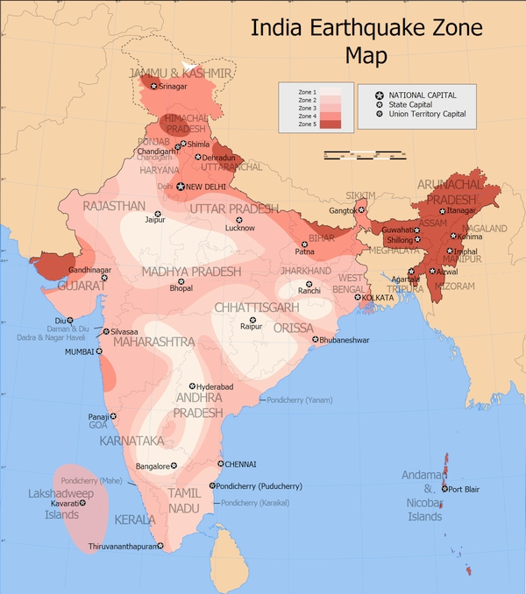
With increasing vulnerability and occurrence of Natural disasters in the most populated, congested and economically under-privileged Developing countries (India, in particular), ingenious implications of Modern technical boon becomes obligatory in order to cope up with the burden of Post-disaster recovery and rescue operations.
Earthquakes costs high in developed Countries
But it DEVASTATES Poor countries

Slide 5

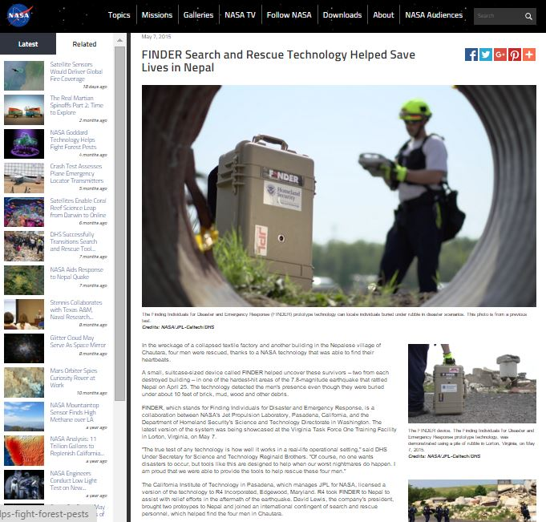

In the wreckage of earthquake, four men were rescued by a small, suitcase-sized device called FINDER, a NASA technology that was able to find their heartbeats.
.
FINDER, which stands for Finding Individuals for Disaster and Emergency Response, is a collaboration between NASA's Jet Propulsion Laboratory, Pasadena, California, and the Department of Homeland Security's Science and Technology Directorate in Washington.

Slide 6


The recovery and rescue actions in developing countries can be highly facilitated with the availability of remotely controlled monitoring robots
With Salient Features of
Cost Effectiveness
Native Technologies
Familiar technologies
Familiar Components
Easy Control Schemes

Slide 7

This inspires us to develop an Autonomous Robotic Module that makes a framework to suit all of the previously-mentioned Requirements

Slide 8

Introduction
to
the Voice Controlled Obstacle Detector Autonomous Bot
(A Mini-Project to fulfill the requirement of B.Tech - M.tech Dual Degree (ETCE) 3rd Semester Final Examination-2015)

Slide 9

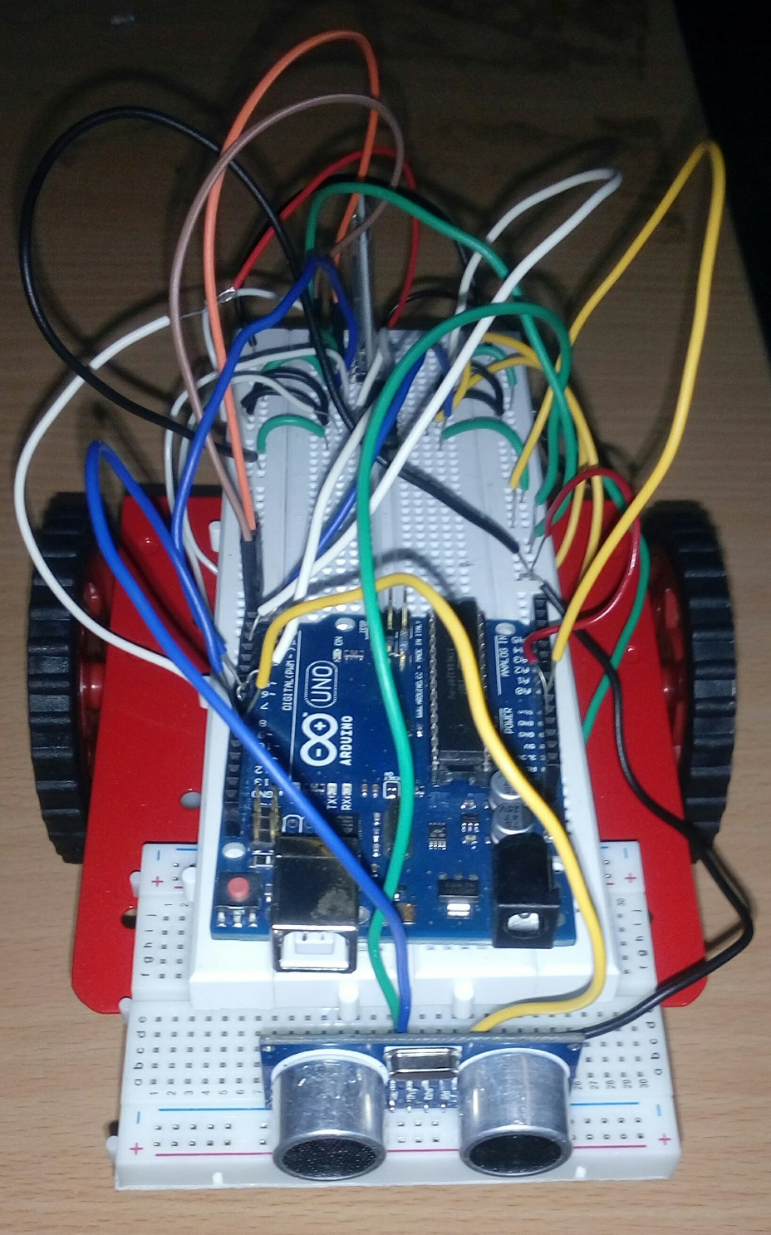
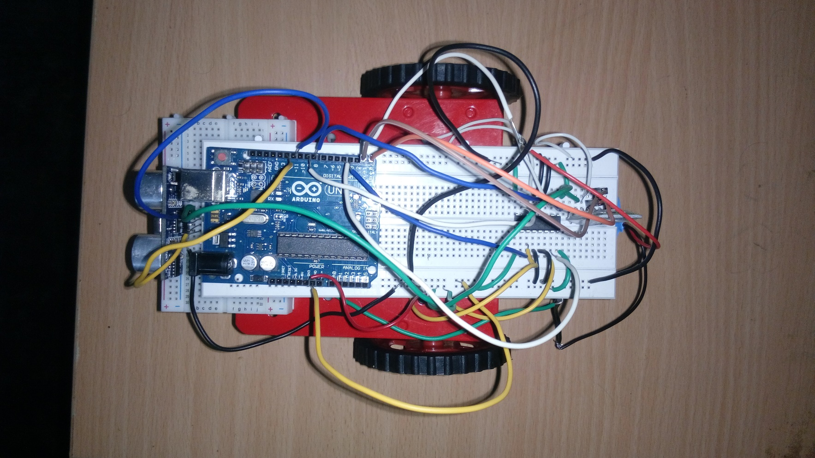
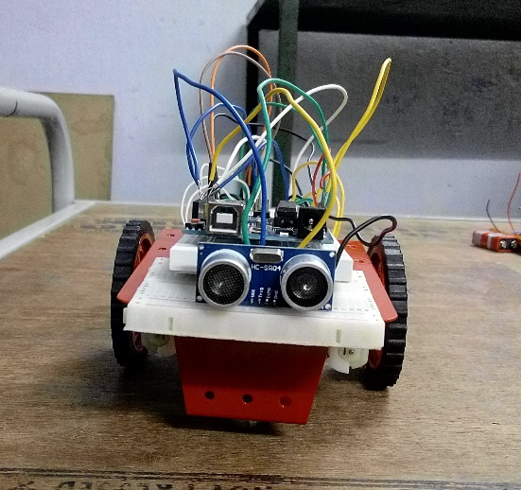
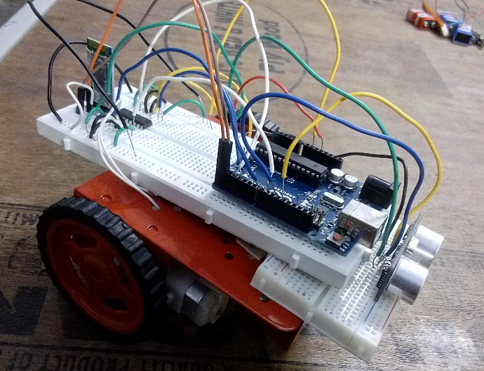
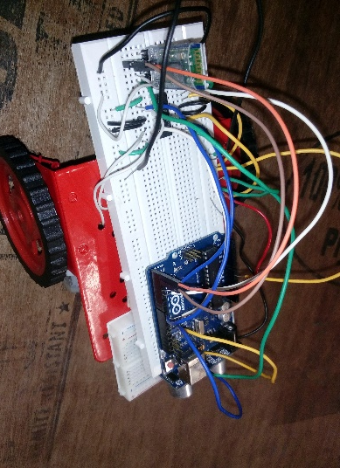

Slide 10

The Bot, provides but a basic framework for such operation, which on installing of monitoring devices, can serve the purposes of (say) video graphic monitoring and storage and rendering the information about the topology of the terrain, most effectively.

Slide 11
Components Used

Slide 12

Arduino

Slide 13

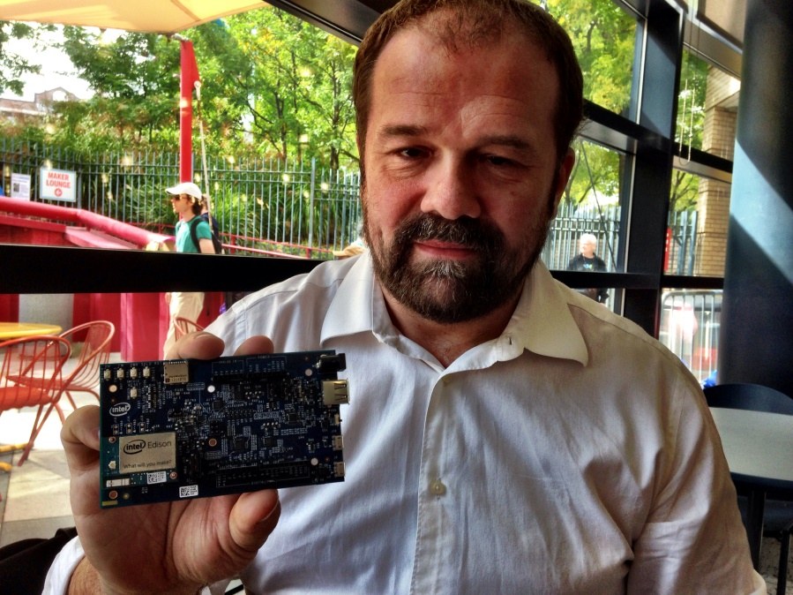
Arduino
Overview:
Arduino- i) Open source computer hardware and software company.
ii) Manufactures microcontroller based kits for digital devices and interactive
objects.
iii) Provides an inexpensive and easy way to create devices that interact with their
environment using sensors and actuators.
Chief designer Massimo Banzi

Slide 14

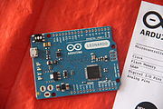
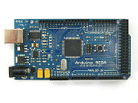
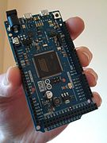
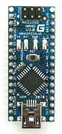
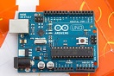
Varieties of Arduino
Arduino Leonardo
Arduino Mega
Arduino Due
Arduino Uno
Arduino Nano

Slide 15

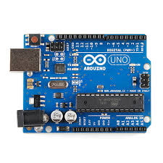
Arduino Uno R3 Board
Most widely used variant of the Arduino.
Features:
i) Atmega 328P microcontroller manufactured by AtMel corporation.
ii) Input voltage - 7-12V
iii) 14 Digital I/O Pins (6 PWM outputs)
iv) 6 Analog Inputs
v) 32k Flash Memory
vi) 16Mhz Clock Speed
Additional Components:
i) USB connection
ii) Power Jack
iii) ICSP Header
iv) Reset Button

Slide 16
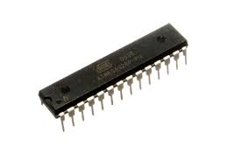

ATmega 328P Microcontroller
Brain of the Arduino Board
Belongs to family of AVR microcontrollers.
Manufactured by the Atmel corporation in 1996.
Uses on-chip flash memory for program storage.
Features:
Flash memory - 32 Kbytes
Pin Count - 32
Max. Operating Freq. - 20 MHz

Slide 17

Bluetooth Module

Slide 18
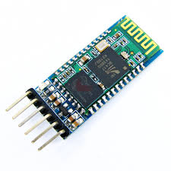
HC-05 Module
Bluetooth SPP (Serial Port Protocol) module.
Easy to Use.
Designed for transparent wireless serial connection setup.
Features:-
i) Low Power 1.8V operation.
ii) Integrated antenna
iii) PIO Control
iv) Default Baud rate : 38400,
v) Data bits : 8
vi) Stop bit : 1
vii) Parity : No parity
viii) Data control : Present

Slide 19

HC-05 Module
Working Principle:-
Android APP
(AMR_VOICE)
Arduino UNO
Received Signal
Transmitted Signal
Bluetooth Module

Slide 20

Ultrasonic Module

Slide 21
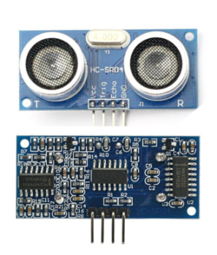
HC-SR04 Module
Uses sonar to determine distance to an object.
Operation is not affected by sunlight or black material.
Consists of ultrasonic transmitter and receiver module.
Features:-
i) Power Supply : +5V DC
ii) Effectual Angle : <15°
iii) Ranging Distance : 2cm – 400 cm
iv) Measuring Angle : 30 degree
Pins:-
VCC : +5V DC
Trig : Trigger (INPUT)
Echo : Echo (OUTPUT)
GND : Ground

Slide 22

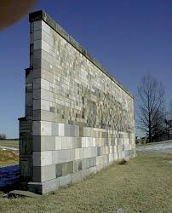
HC-SR04 Module
Working Principle:-
Emitted Wave
Reflected Wave
Ultrasonic Sensor
Obstacle

Slide 23

Motor Driver IC

Slide 24
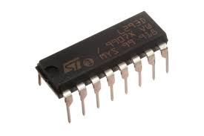
L293D IC
Motor Driver IC which allows DC motor to drive on either direction.
16-pin IC which can control a set of two DC motors simultaneously in any direction.
Motor driver ICs act as an interface between microprocessors and the motors in the robot.
L293D consist of two H-bridge
H-bridge is the simplest circuit for controlling a low current rated motor.
Microprocessors operate at low voltages and require a small amount of current to operate while the motors require a relatively higher voltages and current .
Current cannot be supplied to the motors from the microprocessor. This is the primary need for the motor driver IC.

Slide 25

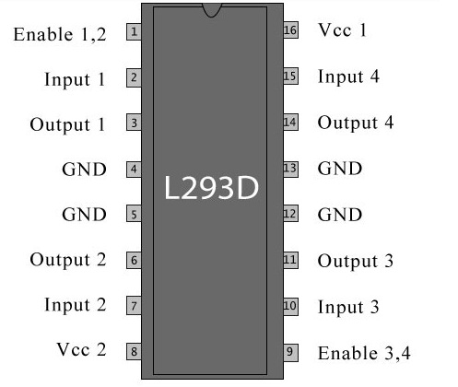
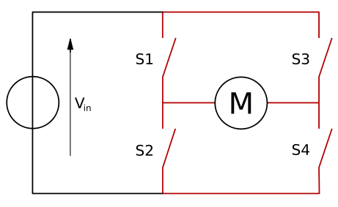
L293D IC
Working Principle:-
H-Bridge
Pin Diagram of L293D IC

Slide 26

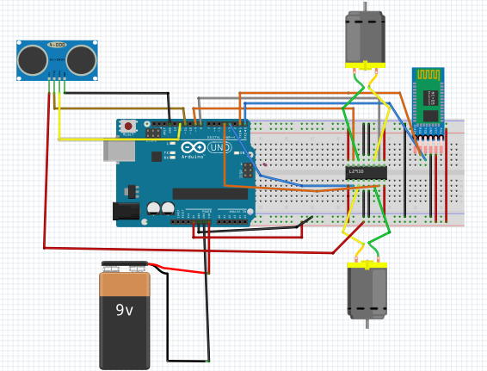
CIRCUIT DIAGRAM

Slide 27

ALGORITHM

Slide 28
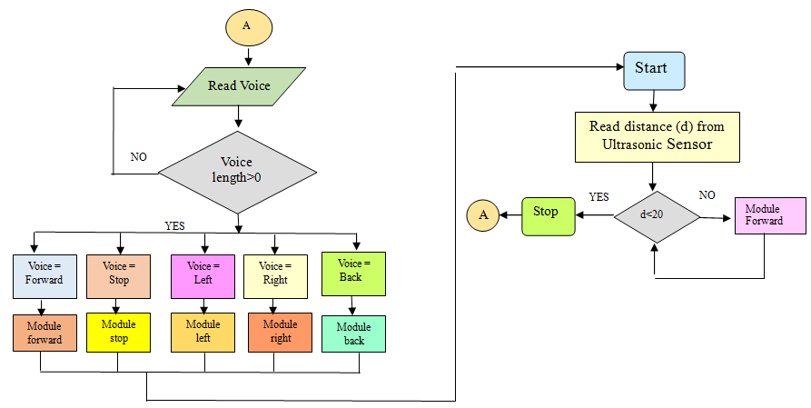
ALGORITHM

Slide 29

CODE

Slide 30
CODE
#define trigPin 11
#define echoPin 12
int ultrasono(int duration, int distance);
long distance,duration;
String voice;
int motor1Pin1 = 3; // pin 2 on L293D IC
int motor1Pin2 = 4; // pin 7 on L293D IC
int motor2Pin1 = 8; // pin 10 on L293D IC
int motor2Pin2 = 9; // pin 15 on L293D IC
void forward(){
digitalWrite(motor1Pin1, HIGH);
digitalWrite(motor1Pin2, LOW);
digitalWrite(motor2Pin1, HIGH);
digitalWrite(motor2Pin2, LOW);}

Slide 31

Continued…
void stop(){
digitalWrite(motor1Pin1, LOW);
digitalWrite(motor1Pin2, LOW);
digitalWrite(motor2Pin1, LOW);
digitalWrite(motor2Pin2, LOW);}
void setup() {
Serial.begin (9600);
pinMode(trigPin, OUTPUT);
pinMode(echoPin, INPUT);
pinMode(motor1Pin1, OUTPUT);
pinMode(motor1Pin2, OUTPUT);
pinMode(motor2Pin1, OUTPUT);
pinMode(motor2Pin2, OUTPUT);}

Slide 32
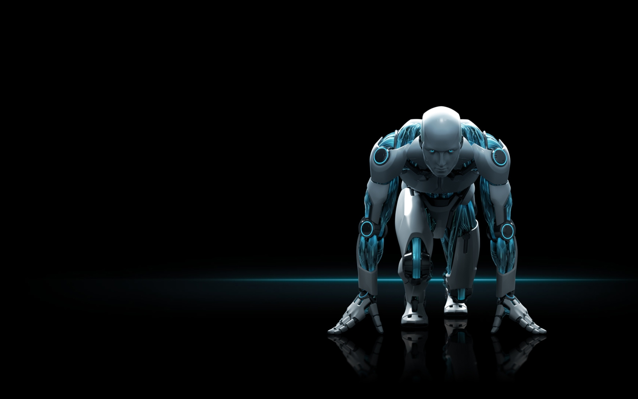
Continued…
void loop() {
distance=ultrasono(duration,distance);
if(distance <= 20)
{
stop();}
else{
forward();}
delay(50);
while (Serial.available())
//Check if there is an available byte to read
{delay(10); //Delay added to make thing stable
char c = Serial.read(); //Conduct a serial read
if (c == '#') {break;} //Exit loop when # is after word
voice += c;} //Shorthand for voice = voice + c

Slide 33

Continued…
if (voice.length() > 0) {
Serial.println(voice);
if(voice == "*forward")
{digitalWrite(motor1Pin1,HIGH);digitalWrite(motor2Pin1,HIGH);
digitalWrite(motor1Pin2,LOW);digitalWrite(motor2Pin2,LOW);delay(1000);}
else if(voice == "*left")
{digitalWrite(motor1Pin2,LOW);digitalWrite(motor2Pin1,LOW);
digitalWrite(motor1Pin1,HIGH);digitalWrite(motor2Pin2,LOW);
delay(3200);stop();}
else if(voice == "*right")
{digitalWrite(motor1Pin1,LOW);digitalWrite(motor2Pin2,LOW);
digitalWrite(motor1Pin2,LOW);digitalWrite(motor2Pin1,HIGH);
delay(3200);stop();}
else if(voice == "*back")
{digitalWrite(motor2Pin2,HIGH);digitalWrite(motor1Pin2,HIGH);
digitalWrite(motor1Pin1,LOW);digitalWrite(motor2Pin1,LOW);delay(2000);}

Slide 34

Continued…
else if(voice == "*stop")
{digitalWrite(motor2Pin2, LOW);digitalWrite(motor1Pin2, LOW);
digitalWrite(motor1Pin1, LOW);digitalWrite(motor2Pin1, LOW);delay(10000);}
voice="";}}
int ultrasono(long duration, long distance)
{ digitalWrite(trigPin, LOW);
delayMicroseconds(2);
digitalWrite(trigPin, HIGH);
delayMicroseconds(10);
digitalWrite(trigPin, LOW);
duration = pulseIn(echoPin, HIGH);
distance = (duration/2) / 29.1;
return distance;
}

Slide 35
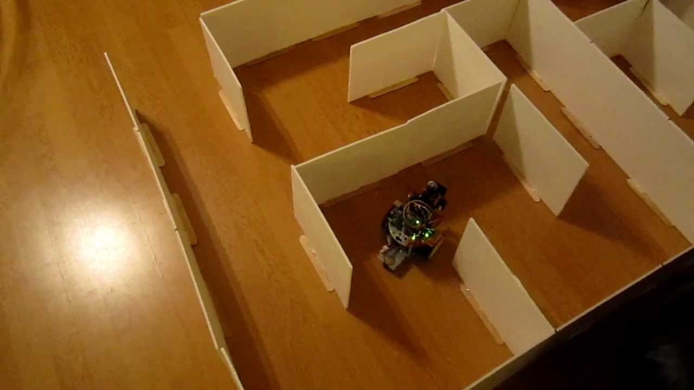

What is the difference between
Our Autonomous Bot and the ordinary wall-follower Robots ?

Slide 36
Better User Control in Accidental Situations
Being struck by an obstacle, the Bot gives the facility to operate it remotely for further movement. This prevents the risk of the device to be blocked at some dead-end.

Slide 37




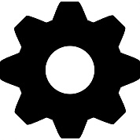


Cost-effectiveness
Better Accidental Control
Native Technology
ADVANTAGES
Customizable to incorporate Other Modules
Familiar & User-friendly Android Platform
Bluetooth Technology
Versatile yet easy Arduino Codes

Slide 38

The effective cost of the device currently stands at ₹1400-1500/-($21-22/-), which is reasonably low as per benchmarks.
But the costs could have been cut down further…

Slide 39
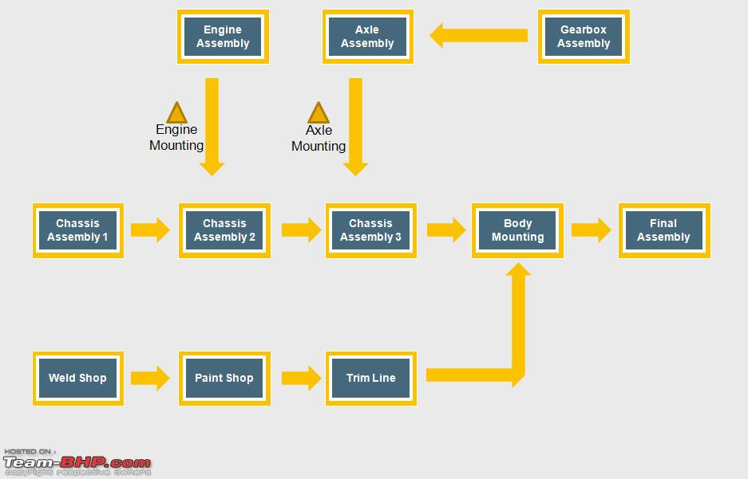
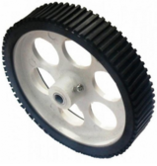
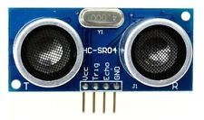
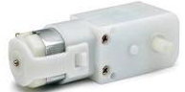
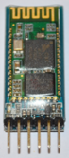
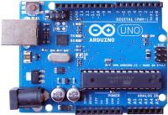
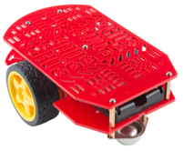
How A Car Industry Operates
How we assembled the Working Model
Different parts coming from neighboring Downstream industries within same Industrial Belt, are assembled in one line, so as to cut down the Cost of Manufacture.
As different components are bought from different places, the cumulative cost hikes; thus the assembly process adds to the burden of Cost .

Slide 40
But our Voice Controlled Obstacle Detector Does have many Limitations apart from the previously mentioned lack of Cost Optimization.

Slide 41
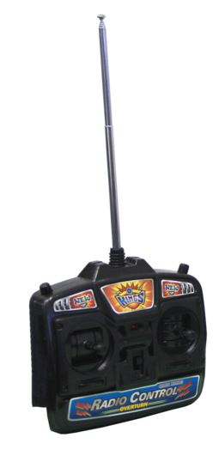
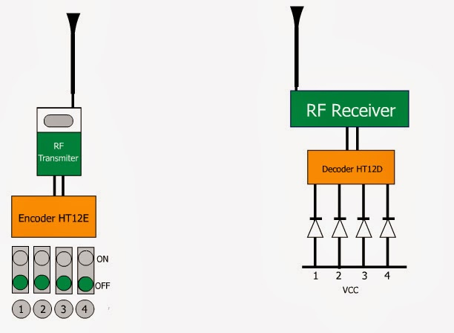
Limitations …
Radio Communication
Bluetooth Technology

Slide 42
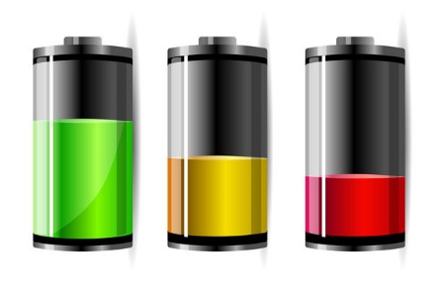
Limitations …
A major deficiency of the device is the supply of power to the device. The 9V battery used in the effective model is drained heavily by Arduino, Motors and other modules, causing inefficiency after a certain time of usage.
Being appropriately powered from Computer, however, the device runs fluently .

Slide 43

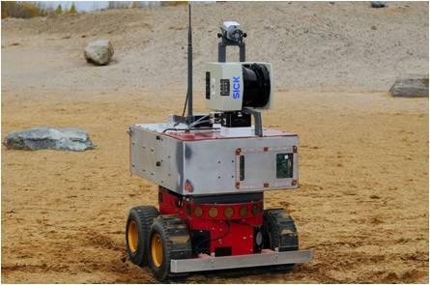
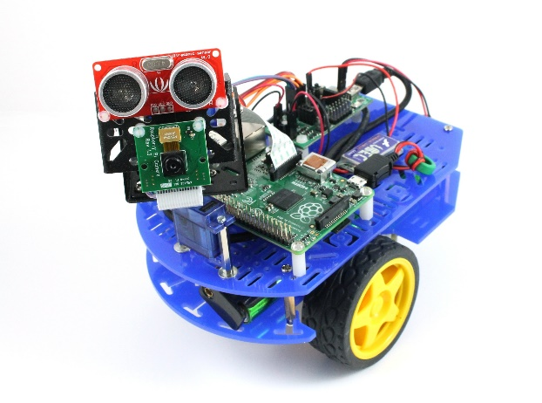
A Basic Framework
This design provides only a Low-cost Working framework for further tools to be incorporated.

Slide 44

FURTHER DEVELOPMENT

Slide 45
Scanning of Terrain Topology
Further Scopes of Development
Indoor Positioning Prototype
Smart Car Prototype

Slide 46
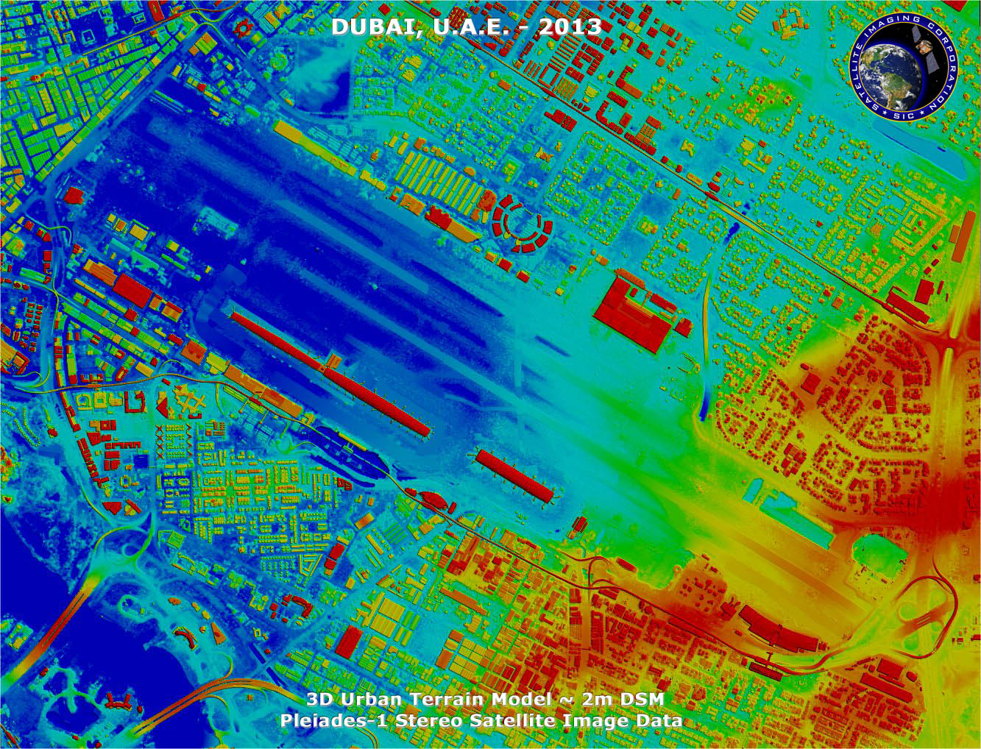
Scanning of Terrain Topology
A camera module may be mounted on the Platform to capture the front view as well as the Topology of the terrain. Using pixellation of the image captured of the obstacles, using image processing techniques, we can infer about the size of the obstacles. Apart form that, recognition of shape of the obstacle can also be perceived using appropriate modules and code.

Slide 47
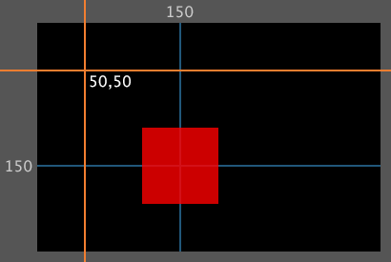

Using multiple Transmitter-Receiver devices around the terrain, we can locate the Position of a certain object using this Bot. This would be highly effective in rescue-cum-recovery operations.

Slide 48
IP techniques can be utilized to find the relative velocity of another moving object ahead of the Bot. In futuristic Smart Cars, this technique could be a basic prototype. Voice-controlling features can then be pronounced with optimized and dedicated A.I.

Slide 49

V
1
Transmitted Signal
V
2
Received Signal
Difference in Positions Measured
Relative Velocity =
Time Elapsed

Slide 50
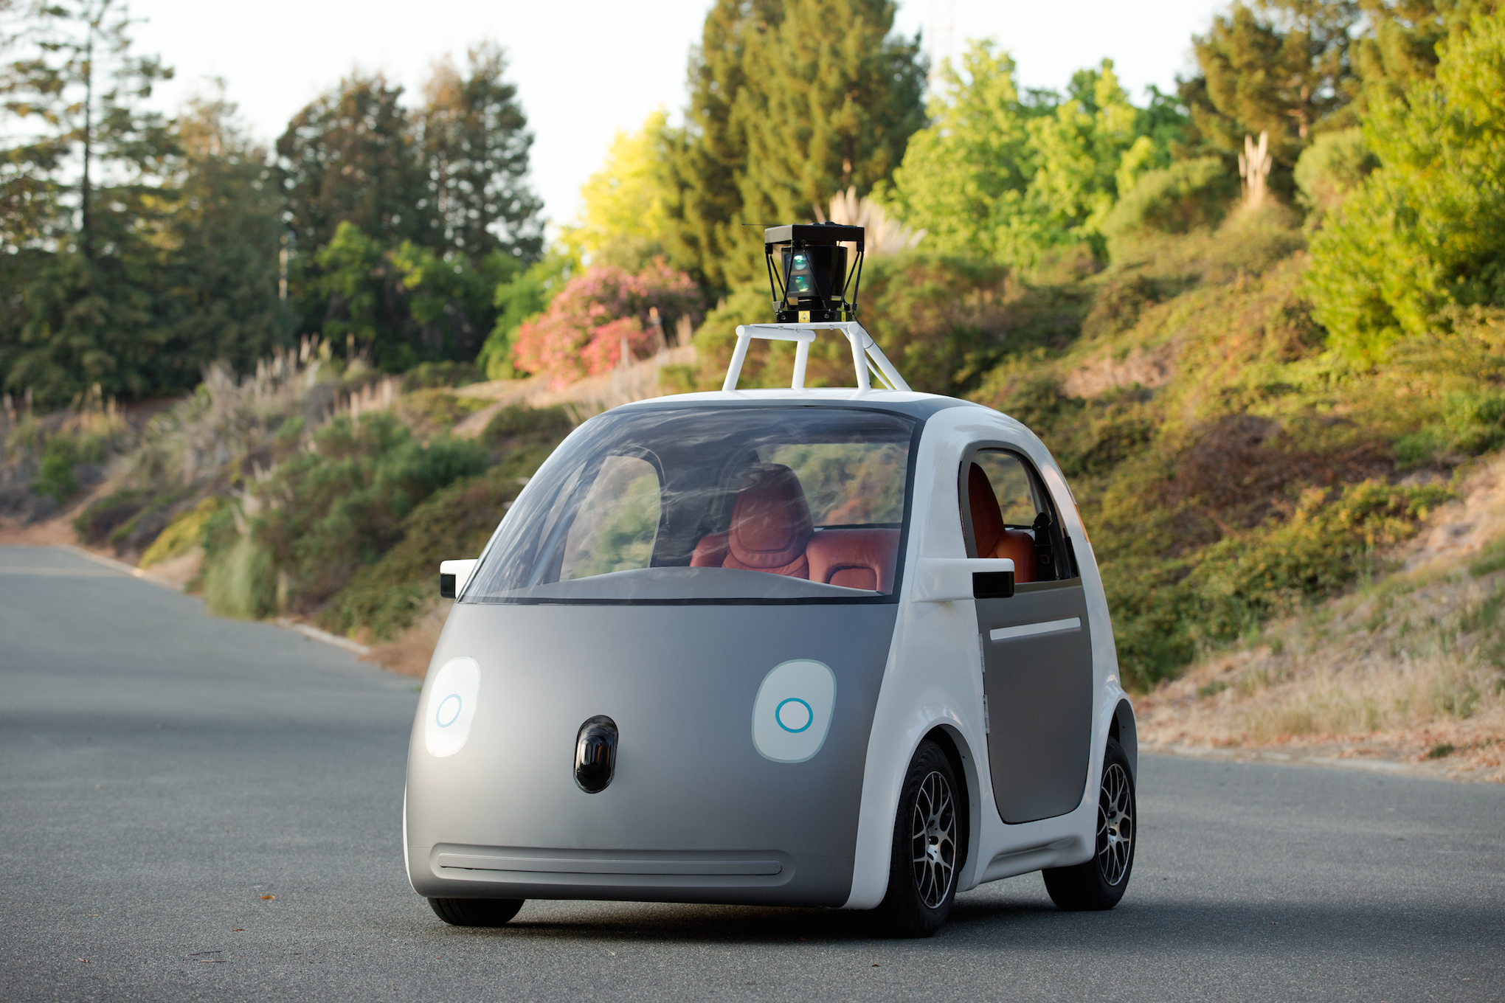
Prototype to Smart Cars
Futuristic Technology tends to incorporate virtual interface on user control of day-to-day devices wrapping 360 degrees of a Lifestyle.
Google and some other Software/Hardware companies are pursuing projects regarding Smart Cars which, apart from being Eco-friendly, uses Voice Recognition and Voice-controlling A.I. for interfacing Physical and Virtual World.
Dedicated A.I. are developed for making Driverless Cars.
Cisco has identified six particular cities spearheading the technological leap forward – Barcelona, Bengaluru, Chicago, Hamburg, Nice, San Jose and Song do, South Korea.

Slide 51

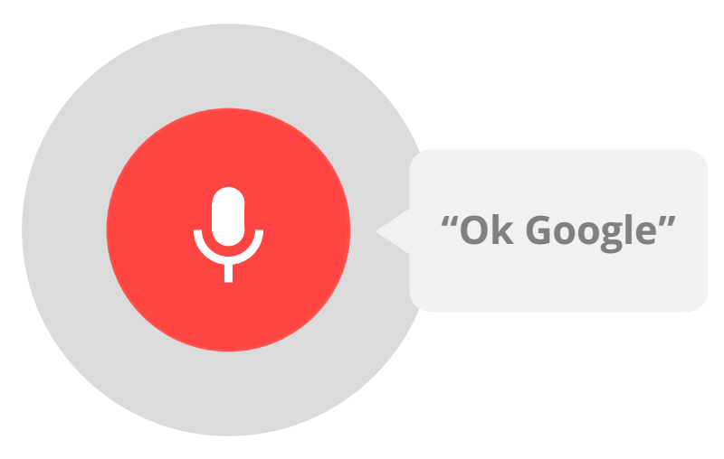
Voice-controlling and Voice-recognition features can then be pronounced with optimized and dedicated A.I.

Slide 52
ACKNOWLEDGEMENT
This work was inspired and supported in part by Prof. Santanu Das, Professor and Head of the Department, Department of Electronics and Telecommunication Engineering, Indian Institute of Engineering Science and Technology, Shibpur.

Slide 53
Reference:
1. https://www.nasa.gov/jpl/finder-search-and-rescue-technology-helped-save-lives-in-nepal
2. http://www.makeinindia.com
3. https://www.arduino.cc
4. http://www.electroschematics.com/8902/hc-sr04-datasheet
5. http://www.simplelabs.co.in
6. https://en.wikipedia.org/wiki/Google_Text-to-Speech
7. http://www.bloomberg.com/bw/articles/2014-08-25/earthquakes-cost-more-in-rich-countries-but- devastate-poor-ones

Slide 54
DEMONSTRATION

